Slide 1
CAPP FOA APPLICATION
Utah CTSI Community and Academic Partnership Pilot (CAPP) Program
Presentation by CAPP Pilot Director
Louisa A. Stark, PhD

Slide 2
agenda
CAPP team introductions
CAPP program overview
Collaborating for a win-win project
Guidebooks for collaboration
CAPP timeline
CAPP application processes
Preparing your budget
Preparing NIH-style biosketches

Slide 3
Appendix
CTSI Acronyms
Grant proposal preparation acronyms
Potential funding and funded grant acronyms
Questions & Answers from presentations about this FOA

Slide 4
CTSI & CAPP Team
CTSI Pilot Program
Louisa A. Stark, PhD, CAPP Pilot Director
Breanne Johnson, Pilot Program Manager, CTSI RSA Committee Co-Chair
Stacey Peterson, CTSI RSA Committee Co-Chair
CTSI Community Collaboration & Engagement Team (CCET)
Ana C. Sanchez-Birkhead, PhD, CTSI/CCET Co-Director
Sara J. Knight, PhD, CTSI/CCET Co-Director
Heather Williamson, CCET Program Coordinator
Hanna Hedges, CCET Program Coordinator

Slide 5
CAPP Web pages
CAPP Funding Opportunity Announcement (FOA)
CAPP-funded projects

Slide 6
Community & Academic Partnership Pilot (CAPP) Program Overview

Slide 7
CAPP Program Focus
To support collaborations between community organizations and CTSI-affiliated academic partners that address at least one of 3 focal areas (see next slides)
To build capacity for community-academic collaborations
To pilot interventions and programs in communities, gathering data to support grant proposals to funding sources outside of the University

Slide 8
Address research barriers
Address barriers to conducting clinical & translational research
An innovative methodology, technology, tool, resource or training program that can be generalized to many other research projects
Example barriers:
Designing clinical trials and research studies with patient/community engagement from the beginning
Engaging a broad range of patients/communities in clinical trials and research studies
Understandable informed consent processes
Disseminating research findings to patients and communities in appropriate and understandable ways

Slide 9
Advance human health
Translate observations/data collected in the community, clinic or laboratory into interventions that improve the health of individuals and communities; e.g.,
Attitude or behavioral changes
Preventive measures
Diagnostics
Treatments or medical procedures

Slide 10
Understand & reduce health disparities
Understand and alleviate inequities in health and health care
Focus on racial/ethnic minoritized groups, rural populations, & groups who experience social and economic disadvantages and barriers to health or health care
(examples on next slide)

Slide 11
Understand & reduce health disparities
Examples of types projects:
Documenting & addressing significant differences in:
disease incidence and prevalence
morbidity, mortality or survival rates
health care delivery and uptake
Understanding social determinants of health, how they contribute to health, and addressing them
Developing/testing approaches to reduce inequities and increase equity in health care delivery or health outcomes

Slide 12
Essential components of CAPP Projects
Close and equitable collaboration between the community and academic partners
Collaboration from the beginning and throughout the project planning and implementation
Both community and academic Principal Investigators on the project
Equitable funding and compensation

Slide 13
Collaborating for a win-win project

Slide 14
components of a win-win project
Community | Academic
Addresses a community-identified need | Addresses researcher interests
Uses a community-appropriate design | Uses rigorous research methods
Increases experience with all phases of research | Increases community engagement experience
Research findings shared with the community | Research findings shared via conference presentations & papers
Leads to community benefit | Leads to larger grant proposals

Slide 16
project planning & grant writing
Multiple meetings between MPIs to plan the project
Share preferred ways to communicate
Gathering input from community members on project design
Co-design with a Community Advisory Board
Focus groups, interviews, surveys
Collaborate in writing the grant proposal
One person drafts the entire proposal or people draft agreed-upon sections
All review and revise/edit proposal drafts
Collaborate in preparing a realistic budget that covers community partner expenses and includes appropriate participant compensation

Slide 17
IRB Application
Collaborate on developing informed consent documents and processes
Plain language
Culturally and linguistically appropriate

Slide 18
Developing focus group, interview or survey questions
Use CAB or focus group(s) to inform question development and/or provide feedback on questions
For surveys, conduct “think-aloud” sessions with representative individuals to identify any issues in understanding the questions
Consider using validated surveys from published research studies
For knowledge assessments, use an item development process to validate items¹
¹ Bass KM, Drits-Esser D, Stark LA. (2016). A primer for developing measures of science content knowledge for small-scale research and instructional use. CBE-Life Sciences Education 15(2), 1-14, doi:10.1187/cbe.15-07-0142. PMID: 27055776

Slide 19
Collecting Research Data
Prepare clear instructions and training for participant recruiters on:
the characteristics of individuals who are eligible (and not eligible) to participate in a research study
appropriate types of interactions with potential participants
importance of non-coercive interactions with potential participants
All individuals who interact with potential research participants and participants must have CIRTIfication or CITI Human Research training

Slide 20
analyzing & interpreting Quantitative data
If data analysis is done by academic personnel:
Prepare tables, charts and graphs to share the findings
Hold a ”data party” with the community MPI / research team to discuss the data
Discuss the findings as a team and agree on interpretation(s) of the data

Slide 21
analyzing & interpreting qualitative data
Collaboratively decide how to analyze the data
As a team?
If one partner does an initial analysis, collaboratively discuss the draft analysis to ensure that everyone interprets the themes and representative quotes in the same way
If you have a CAB, consider obtaining their input on the draft data analysis

Slide 22
sharing research findings with others
Plan one or more ways to share the research findings with participants and community members
Present posters, oral presentations, or breakout sessions at professional academic conferences
MPIs collaboratively prepare abstracts and presentations
Include budget for community MPI to present at conferences
Write and submit manuscripts to academic journals
Use language in the manuscript that reflects your community-academic partnership as researchers
Include both MPIs and appropriate other members of both teams as authors and in reviewing/commenting on the manuscript

Slide 23
Guidebooks for collaboration

Slide 24
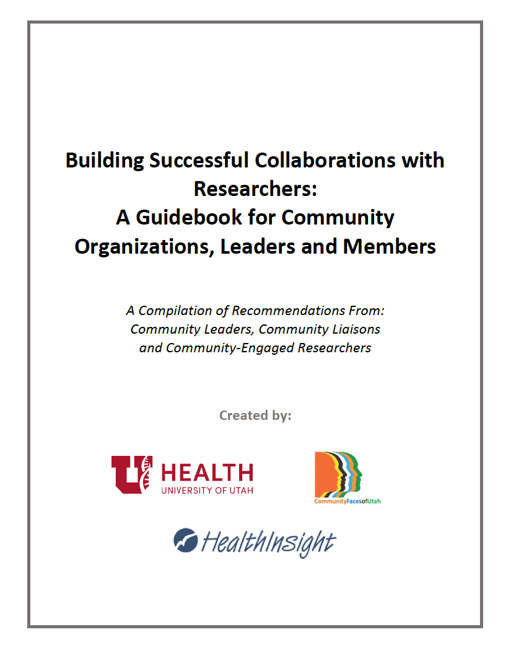
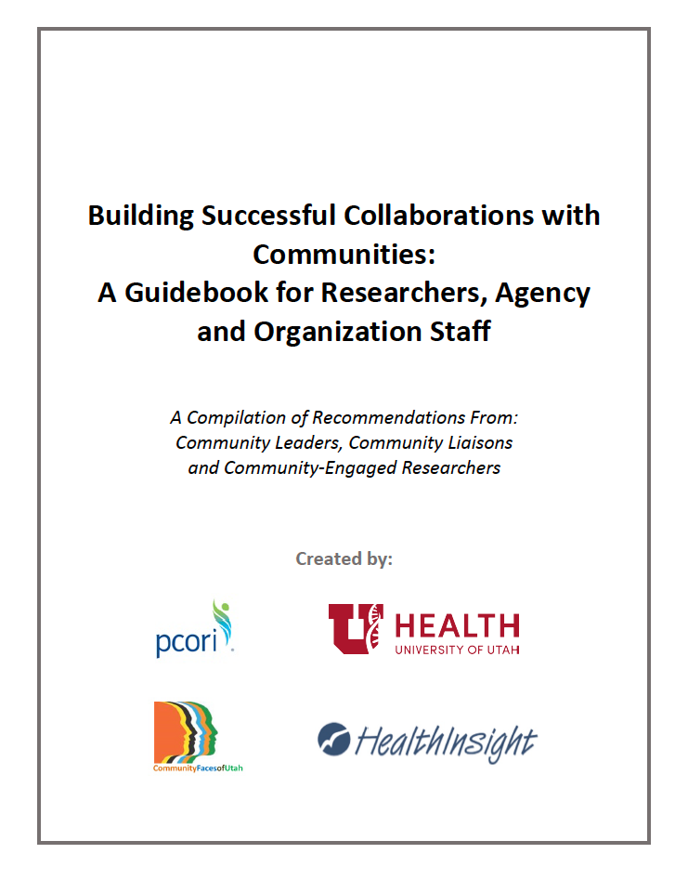
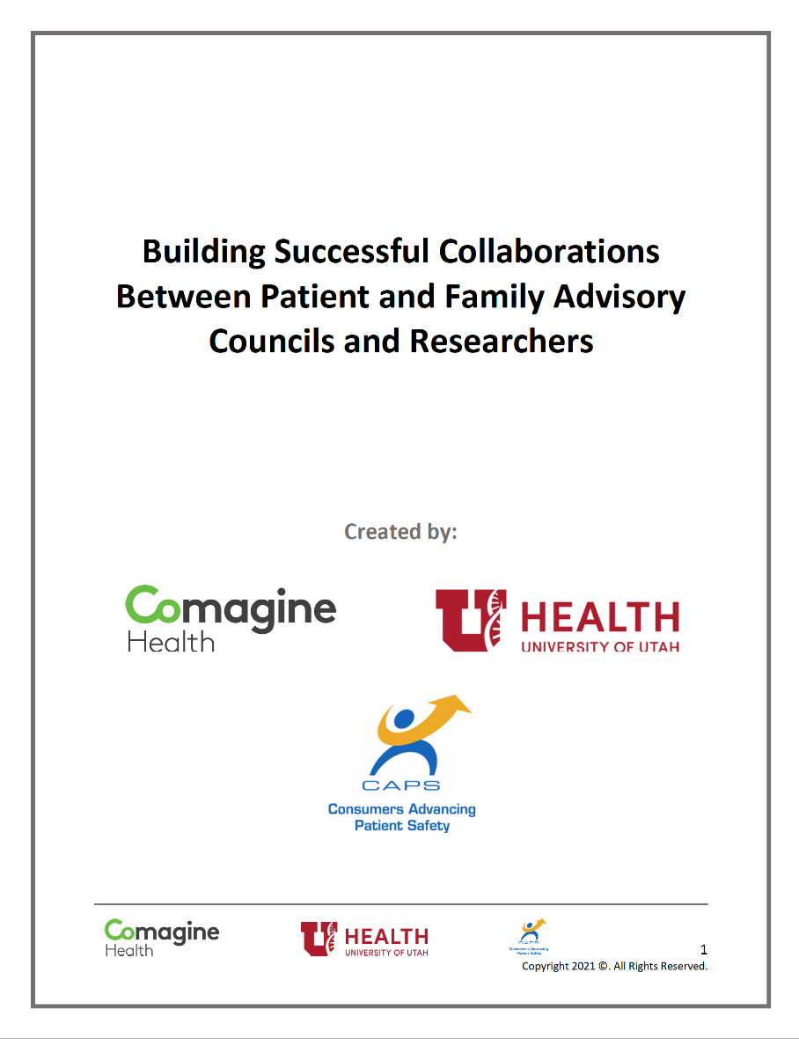
CCET Guidebooks for collaboration

Slide 25
CCET Guidebook URLs
Stark LA & Coulter H, eds. (2018, 2021). Building Successful Collaborations with Communities: A Guidebook for Researchers, Agency and Organization Staff. HealthInsight, University of Utah Health, and Community Faces Utah. Available at https://www.gslc.utah.edu/Researcher-Guidebook.pdf
Stark LA & Coulter H, eds. (2018) Building Successful Collaborations with Researchers: A Guidebook for Community Organizations, Leaders and Members. HealthInsight, University of Utah Health, and Community Faces of Utah. Available at https://www.gslc.utah.edu/Community-Guidebook.pdf
Stark LA & Brown H. (2021). Building Successful Collaborations Between Patient and Family Advisory Councils and Researchers. Comagine Health, University of Utah Health, and Patients Advancing Consumer Safety. Available at https://www.gslc.utah.edu/PFAC-Guidebook.pdf

Slide 26
Guidebook Topics
Getting to know each other
Initial and subsequent meetings
Collaboratively planning and carrying out all aspects of a project
Research Project Planning Guide
Example templates and documents
Patient and Family Advisory Committee (PFAC) Guidebook
Questions to ask researchers in a consultation about a project

Slide 27
CAPP Timeline

Slide 28
Capp timeline
Sep. 15
Letter of Intent
(LOI) due
October
Nov. 3
Invitation to submit full proposal
Nov. 3 – Dec. 18
Dec. 18
Application Due Date
(full proposals due)
5:00 pm MST
January
Feb. 1
Notice of intent to fund
Apr. 1
LOI Review Panel
Full Application preparation with Advisor, CCET, and Design
Full proposal review panel
Earliest start date for funded projects

Slide 29
CAPP application processes

Slide 30
Letter of Intent (LOI) Preparation
MPIs prepare and submit a Letter of Intent (LOI), applying to submit a full grant proposal – due September 15, 2023
Cover Page (1 page)
Project title, community & academic Principal Investigator information, key personnel information, composition and qualifications of the project team
Community-Academic Partnership Description (1 page)
Partnership history, ways in which all partners have been involved in developing the proposed project, responsibilities of each partner, ways in which the project will be beneficial (“win-win”) to both partners
Research Strategy (3 pages)
Specific Aims – the project goals
Significance and Rationale – benefits, innovation, importance
Methods – how you will carry out the work
Expected Outcomes and Metrics for Success
Bibliography & Literature Cited (no page limit)
Biosketches - one for each Principal Investigator in NIH format

Slide 31
LOI Review
LOIs are reviewed by a panel of community leaders and CTSI researchers who are experienced in community engaged and translational research
Each LOI will be read and received a written review from 3 reviewers
The reviewers share with the entire panel their initial overall score for each proposal and present their assessment of its strengths and weaknesses, based on the review criteria
After the panel discusses the proposal, the reviewers give it an updated overall score (1-9)
All panel members submit a final overall score
The overall scores are averaged
The highest-scoring proposals are invited to submit a full proposal

Slide 32
CAPP application Development Support
Both MPIs are expected to participate in all development support meetings
Meetings may be cancelled and rescheduled if only 1 MPI is present at the beginning of the meeting
MPIs will meet with an assigned Advisor at least once
Advisor’s role: To support the MPIs in improving aspects of the application that the LOI reviewers noted as weaknesses
May recommend meeting with specific CTSI Cores/Services
Contact: Rebekah Hendon, CTSI Intake and Navigation Manager
MPIs will meet with a CCET Co-Director
Provide expertise in specific aspects of applications
Support focusing applications on CAPP project objectives
Recommendation: Begin scheduling meetings immediately after notice of LOI acceptance

Slide 33
CTSI cores and services
Community Collaboration & Engagement Team (CCET) Services
Engagement Sessions
Focus Groups
Community Advisory Boards
Community Dialogues
Interviews
Return of Results sessions with community participants

Slide 34
CTSI cores and services
Translational Research: Implementation, Analysis & Design Team
Study Design & Biostatistics
Cancer Biostatistics
Health Economics
Qualitative Services
Survey Design & Measurement
Systematic Review
Clinical Research Unit (space and nursing services for clinical research)
Biomedical Informatics Core
Cellular & Translational Research Core
Clinical Research Support Office

Slide 35
Full Applications
Due December 18, 2023
Cover Page (1 page)
Similar to LOI with an Abstract and Lay Summary
Description of changes made following advisor consultations and design sessions (1 page)
Community-Academic Partnership Plan (1 page)

Slide 36
Full Application, continued
Research Plan (5 pages)
Specific Aims
Background and Significance
Innovation
Research Design and Methods
Bibliography and Literature Cited
Plan to Obtain Additional Funding (1 page)
Identify specific funding opportunities by FOA number and name
Draft IRB application

Slide 37
Full Application, continued
NIH Biosketches
Principal Investigators
Key Personnel (academic and community)
Letters of Support (optional)
Budget (use provided template)
Separate budgets for community and academic partners
Budget Justification (3 pages)

Slide 38
What happens after you submit your application?
Full application review
Panel of community leaders and CTSI-affiliated researchers who are experienced in community engaged research (similar to LOI review)
Final funding decision
CTSI Co-PIs discuss the review panel’s scoring and reviews and make the final funding decision

Slide 39
preparing your budget

Slide 40
Budget Development
Allows up to $60,000
Required to detail the budget in 2 pieces:
Academic
Community partner
Budget should reflect actual needs and justifiable reason
No set limit for either side – must stay within the overall budget cap

Slide 41
Budget Development – Community partner
Typical expenses may include:
Incentives for research participants
Including food and beverage, if justified; additional approval from CTSI required
Payments or other incentives for Community Health Workers or other individuals to recruit participants, carry out a program, and/or collect data
Including food and beverage, if justified; additional approval from CTSI required
Payment for community leaders/members for work performed outside of normal job scope when necessary for the completion of the project
Supplies needed to conduct the research project
Charges for CTSI services such as engagement sessions, survey design, or statistical analysis
Travel to present or co-present project findings at professional conferences
Dissemination events with research participants and/or community members
Including food and beverage, if justified; additional approval from CTSI required
The following costs are not covered by these awards:
Alcoholic Beverages

Slide 42
Budget Development – Academic partner
Typical expenses include:
Incentives for research participants
Technical supplies needed to conduct the research project
Charges for CTSI services such as engagement sessions, survey design, or statistical analysis
The following costs are not covered by these awards:
Faculty salaries
Post-doctoral salaries for those already listed as a trainee on a T grant
Graduate student stipends or tuition (stipends are from grants or other awards)
Monetary incentives for health care clinics to participate in research
Meals or hospitality (i.e., no food, beverages, or alcohol)
Travel that is not directly related to the conduct of research (including travel to conferences to present findings)
Other items typically supported by indirect costs

Slide 43
Budget Development – Guidelines to follow
Contact consultants or service-based contacts (such as CTSI Cores & Services) early on to get a quote – do not estimate or use rates on CTSI website
Statistical support is available through the CTSI for grant applications
Create a project timeline with milestones and consider each cost required along the way (development, printing, travel, etc.)
Fringe benefits should be included for any University support staff member
If funded, prepare for administrative effort to set up budget and payment terms
i.e. data sharing agreements, consultant agreements, data use agreements
Don’t UNDERESTIMATE the amount of time these take

Slide 44
Budget Development – General Budget Guidelines
Read budget regulations carefully.
Meals – NIH only allows meals in unique circumstances; discuss any request to include meals for community meetings with the CAPP program administrator.
Gift cards – NIH allows these to be used for participant compensation, but a payment log must be kept.
Budget should not be left for the end of the process – budget limitation can impact the scope of your work!
Set up a time to review your budget.
Review the FOA & ask questions.

Slide 45
NIH Biosketches

Slide 46
NIH BIOSKETCH & Other SUPPORT
Required for all NIH sponsored grant proposals – used very frequently for health sciences
Used to highlight an individual’s qualifications for a role in a specific project.
Template found online, search for “NIH 2022 BIOSKETCH”, ensure you use Forms G
https://grants.nih.gov/grants/forms/biosketch.htm
Consists of 3 sections:
Initial Information Table
A. Personal Statement
Mention specific contributions to science
Ongoing and Completed Research Support
B. Positions, Scientific Appointments and Honors
C. Contributions to Science

Slide 47
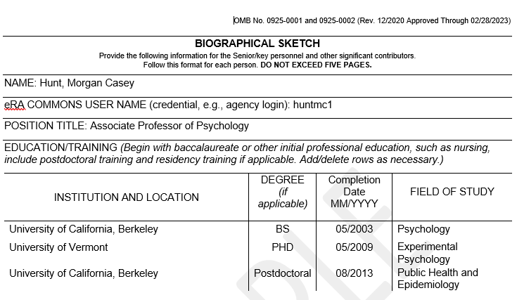
Initial Information – Academic Example

Slide 48
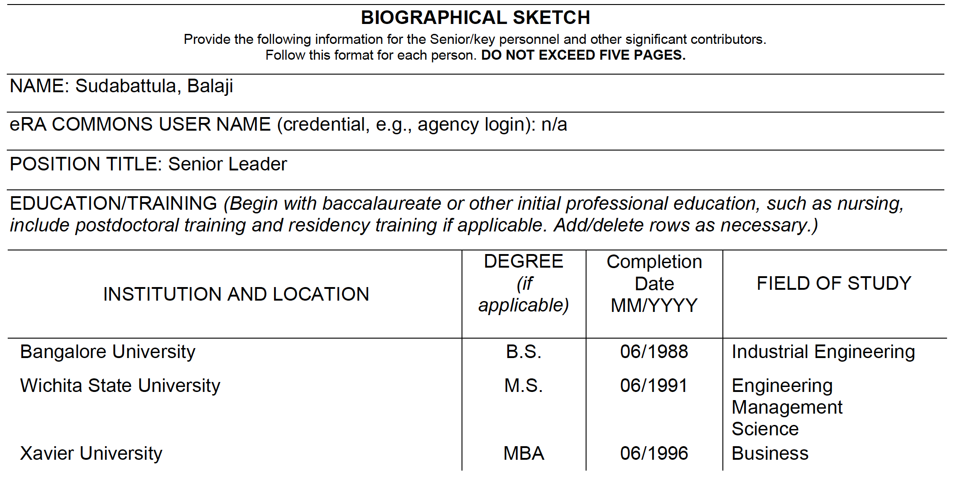
Initial Information – Community Example

Slide 49
A. Personal Statement
MARKET YOURSELF – Why are you the best person for the project? What is great and unique about your skills?
Related past work experience or education
Environment (availability to reach intended participants)
Technical expertise
No figures, tables, or graphs allowed (text only)
Reviewers want to see that you are qualified for the role and will be able to provide the necessary network and skills to successfully carry out the proposed project

Slide 50
A. Personal Statement – Cont.
Can cite up to four publications – but NOT required!
Ongoing and completed research projects that you would like to highlight
- within the past three years
Required details for research projects you list:
Grant award number, if applicable, or name of the funder
PI/ MPI last name(s)
Project title
Your responsibility/role
Beginning and ending dates for the project

Slide 51
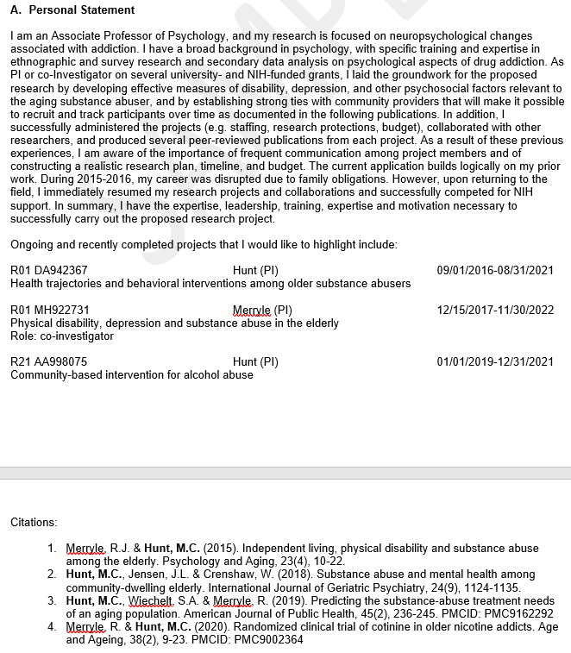
A. Personal Statement – Academic example

Slide 52
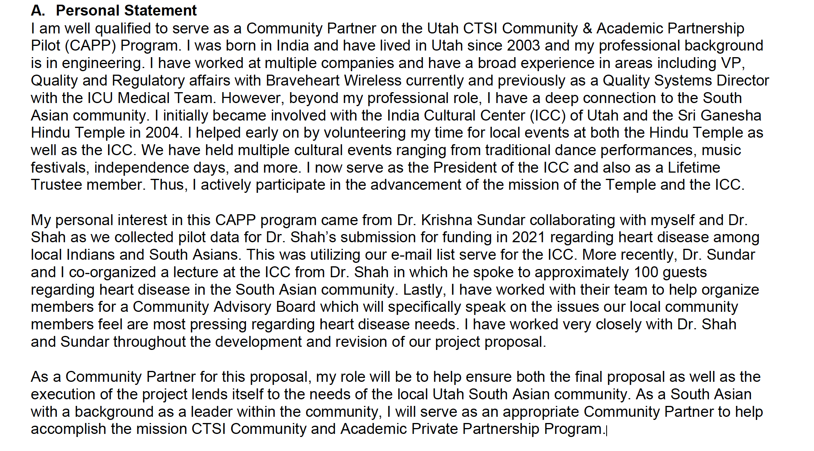
A. Personal Statement – Community Partner example
SAMPLE

Slide 53
B. Positions, Scientific Appointments and Honors
Sub-titles can make it easier for reviewers to read:
Positions and Scientific Appointments
List in reverse chronological order
All current positions and scientific appointments (can leave blank for current, i.e., “2001 – Present”
This includes titled academic, professional, or institutional appointments whether or not remuneration is received, and whether full-time, part-time, or voluntary (including adjunct, visiting, or honorary).
Honors
List any relevant academic and professional achievements and honors
Reviewers want to see that your education and experience match with what you wrote in your personal statement

Slide 54
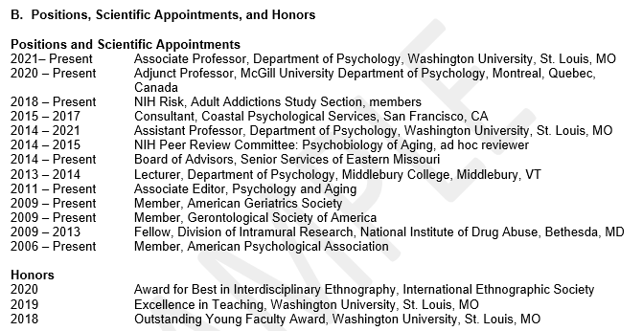
B. Positions, Scientific Appointments, and Honors – Academic Example

Slide 55
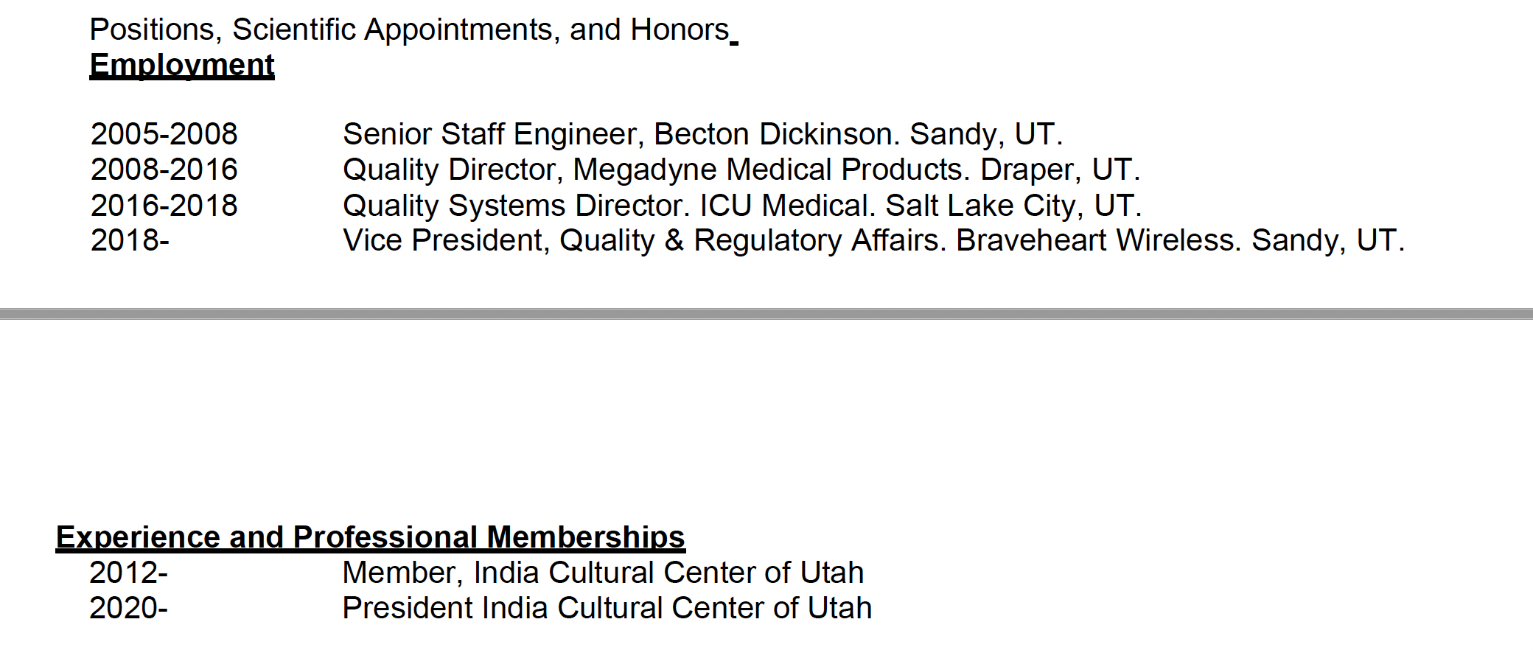
B. Positions, Scientific Appointments, and Honors – community Example

Slide 56
C. Contributions to Science
Brief description of UP TO 5 of your most significant “contributions to science”
Each description should be half page or less, including citations
may have up to 4 citations for each
citations can include publications, conference abstracts, posters or other presentations, educational aids, etc.
Academic: Each Contribution should include (Figures, tables, or graphics are not allowed):
the historical background that frames the scientific problem;
the central finding(s);
the influence of the finding(s) on the progress of science or the application of those finding(s) to health or technology; and
your specific role in the described work.
Community: Can think “outside the box” for Contributions; for example:
Programs and/or projects
Past partnerships
Community or other advisory board service
Community presentations
Meeting/conference presentations
Advocacy

Slide 57
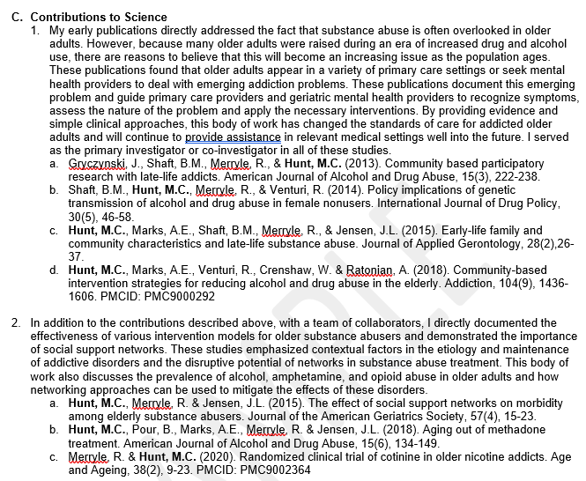
C. Contributions to Science – Academic example

Slide 58
C. Contributions to Science – Community Partner examples
Example 1
Example 2

Slide 59
Thank you & Questions?

Slide 60
CTSI Acronyms

Slide 61
CTSI Acronyms
NIH NCATS
National Institutes of Health, National Center for Advancing Translational Science – funding from NCATS supports the Utah CTSI
CTSI – Clinical & Translational Science Institute
The funder for the CAPP, utilizing University of Utah institutional funds
Includes 12 Cores and Services
CCET – Community Collaboration & Engagement Team
The Core within the CTSI that oversees the CAPP
CAPP – Community-Academic Partnership Pilot Program
The Funding Opportunity Announcement (FOA) you are applying to
RSA Committee – Research & Science Advisors Committee
CTSI committee members who serve as advisors to CAPP proposals

Slide 62
Common grant proposal preparation Acronyms

Slide 63
Grant Proposal preparation Acronyms
PI / MPI – Principal Investigator/ Multiple Principal Investigators
These individuals are responsible for all aspects of applying for, carrying out, and administering a research grant
Bio – Biosketch
A summary of an individual’s education/training, experience and accomplishments
The project teams’ Bios illustrate that, together, they have the expertise needed to successfully carry out the proposed research project
LOI – Letter of Intent
A document indicating intention to submit a full grant proposal if the LOI is accepted
LOS – Letter Support
A letter from an individual or organization confirming their intent to provide services or other support if a grant proposal is funded

Slide 64
grant proposal preparation Acronyms
Pre-award – the time period before a grant is awarded; includes:
Preparing all parts of your grant proposal
Meetings with Advisor, CCET, and design consultations with CTSI Cores & Services
IRB application draft (if applicable)

Slide 65
Common Potential Funding and funded grant Acronyms

Slide 66
Potential Funding Acronyms
Notice of Intent to Fund
Notification that your project has been selected for funding if you meet the JIT requirements
JIT – Just-in-Time Period
The time period between the “Notice of Intent to Fund” and the “Notice of Award”
The following must be submitted during this time:
IRB approval for the project
Completion certificates for required trainings:
CIRTification for community MPIs
CITI Human Research & GCP for academic MPIs
Budget reallocations if the project needs to modify its budget due to changes that took place after the grant proposal was submitted
Setting up the community partner subaward with the University

Slide 67
Potential Funding Acronyms
CIRTification Training
An online training in “human research protection” for community members
It outlines the ways in which research studies must protect participants’ privacy, confidentiality, well-being, etc.
Must be completed by all community project team members who will interact with research project participants

Slide 68
Funded grant Acronyms
NOA – Notice of Award
Official notification that a grant proposal has been funded
Includes the terms and conditions of the award
Post-award – the time period after a grant is awarded
Funds are awarded
Carry out the project as approved by the IRB
3-month and 6-month presentations on progress
Final presentation

Slide 69
Questions & Answers
Community & Academic Partnership Pilot (CAPP) Program
Questions – ’23 Presentation

Slide 70
Community Academic Partnership Pilot Program
Question: Does using technology to increase access to services among immigrants fall under the first or last focus?
Answer: The first focus is on translational research. There is a difference between translational science and translational research. If the technology could be translated and used by many other projects this is considered translational science.
Question:
Define the difference between a community partner and a community organization.
Answer: A community partner or community organization is defined as not a part of the University of Utah, VA or Intermountain Healthcare. These are considered academic partners. Community organizations are typically nonprofit organizations.
Question: Does the funding extend beyond a year?
Answer: No. The funding for the CAPP cannot be extended beyond the one year. You must spend the grant money within the one-year timeframe.

Slide 71
Questions & Answers
Community & Academic Partnership Pilot (CAPP) Program
Questions – ’22 Presentation

Slide 72
Community Academic Partnership Pilot Program
Question: Are we assigned a CCET co-director?
Answer: A CCET co-director assignment was in an email the MPIs received. The MPIs are responsible for arranging and scheduling a meeting with the co-director.
Question: As we further prepare our proposal, do we have access to the CTSI Core Services without cost?
Answer: Free consultation during the grant preparation time is available. If you plan to utilize CTSI Core Services as part of a funded project, you must include those costs in your grant proposal budget.
Question: Can participants be paid using cash?
Answer: No. Cash is not allowed. All participants must be compensated in the form of a gift card. Gift cards are acceptable due to tracking mechanisms and compliance. The CCET Team regularly compensates participants via gift cards and can provide information on how to do this.

Slide 73
Question: Do community key personnel need to provide and submit a Biosketch?
Answer: Yes. Community key personnel should provide a current Biosketch.
Question: Should any specific adaptation of the community key personnel Biosketch be made?
Answer: You may modify the Biosketch as needed to highlight community members’ experience and expertise. Usually, Sections A and B will be filled out completely. Section C may contain contributions to an individual’s community and/or accomplishments. The Biosketch should highlight an individual’s expertise in areas that are relevant to the proposed project.
Question: Are there recommendations for obtaining funding to carry out pre-award activities, such as holding focus groups or Community Advisory Board meetings?
Answer: Departmental funding is an option. Quality improvement meetings can be scheduled and can help develop the project. Quality improvement meetings are for information gathering only.

Slide 74
Question: Do key informant interviews need IRB approval?
Answer: Key informant interviews used as research data will need IRB approval.
Key informant interviews used to explore community needs and interests in developing a research project are acceptable as quality improvement; no IRB approval is needed. Note: For any information used in a publication or presentation, IRB approval is necessary.
It is best practice to consult the IRB for any questions regarding key informant interviews.
Question: Is a community advisory board recommended?
Answer: Yes. A community advisory board is recommended, but not required. It can be useful to have input and feedback from multiple people on the project design, procedures, and ways to share project outcomes with the community.

